Slide 1

Assignment 3: Data Storage

Slide 2



Group 11
Muhammad Wajahat Ali Khan
Inderpreet Singh
Syed Muhammad Bilal Munir

Slide 3
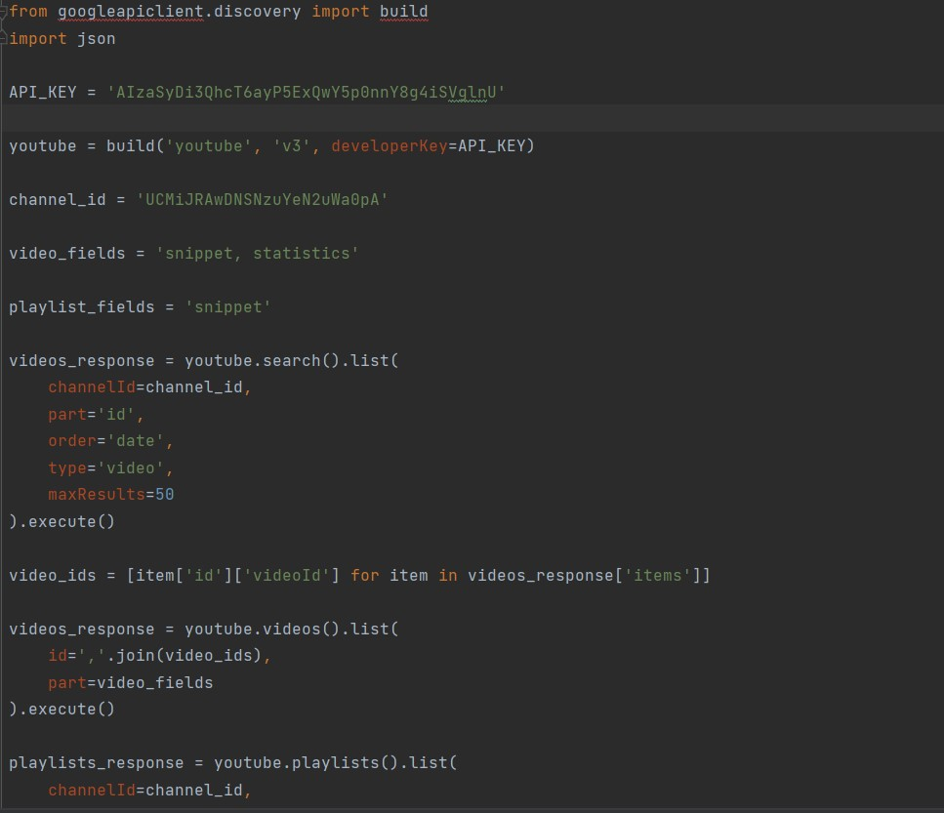
Select your favorite dataset and API( you can use your previous assignment) and download the data.
API Chosen: YouTube API.

Slide 4
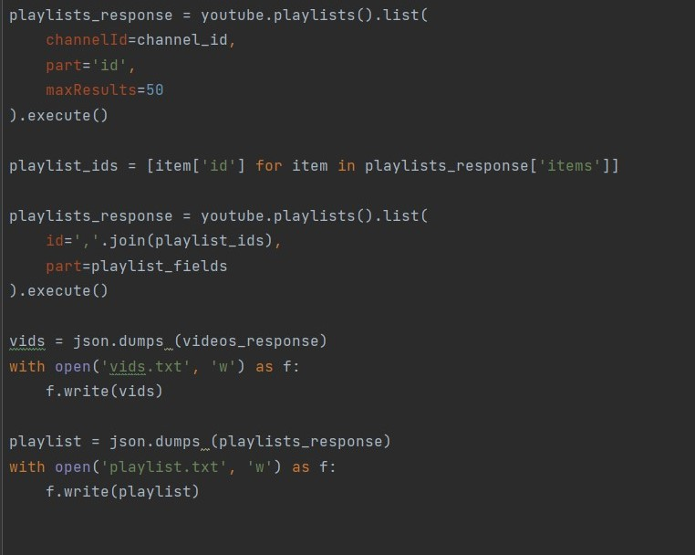

Slide 5
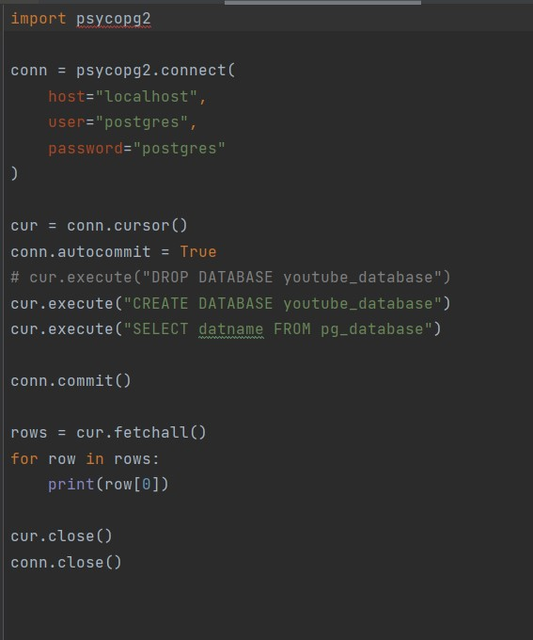
Create a database in PostgreSQL or Google Cloud Platform and make tables based on data attributes. Import data to populate the tables. Show some interesting SQL queries. Use python for all the steps (not PostgreSQL user interface or PgAmin).
1. Create Database

Slide 6
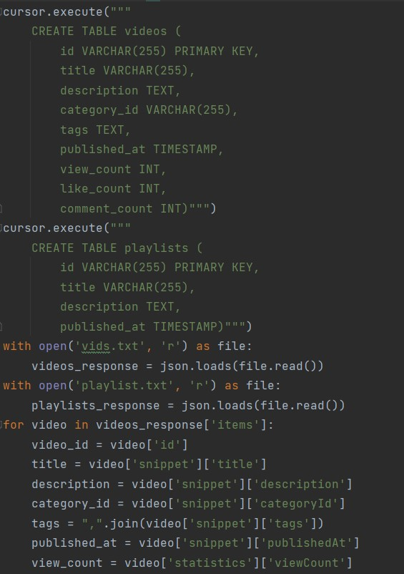
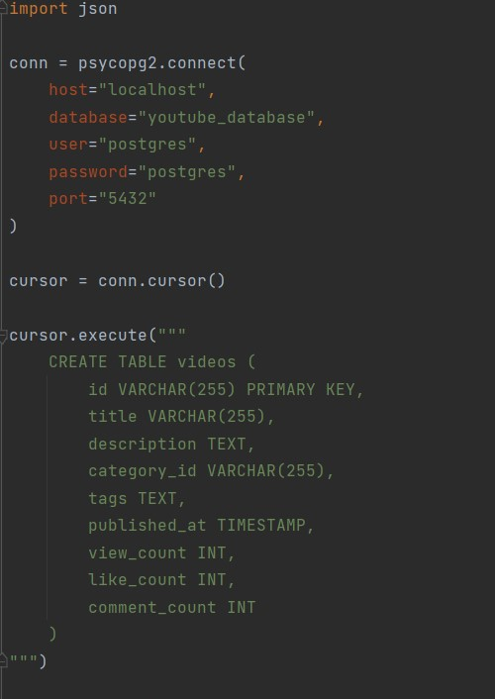
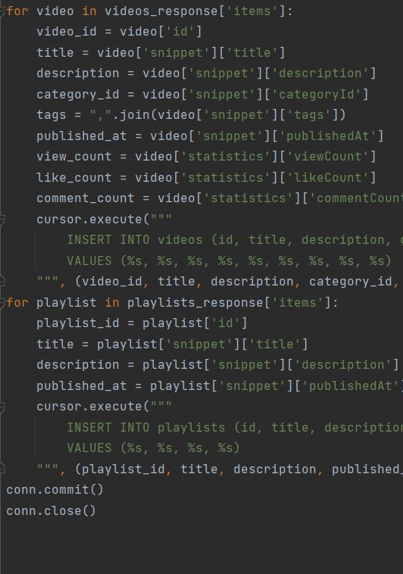
Insert Into Tables

Slide 7
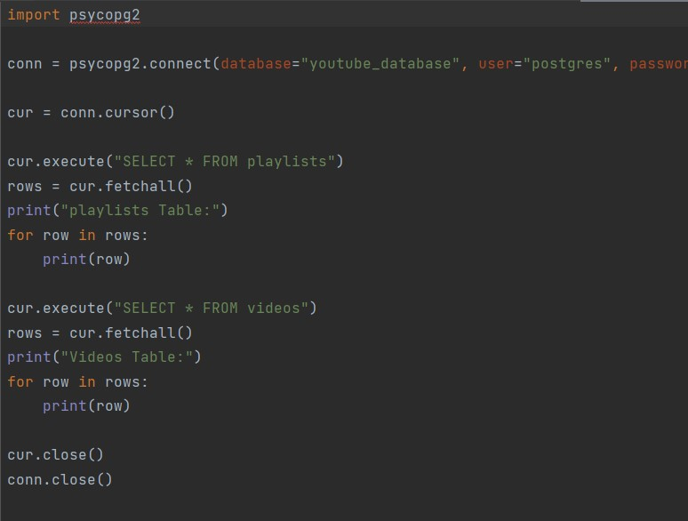
View Data

Slide 8
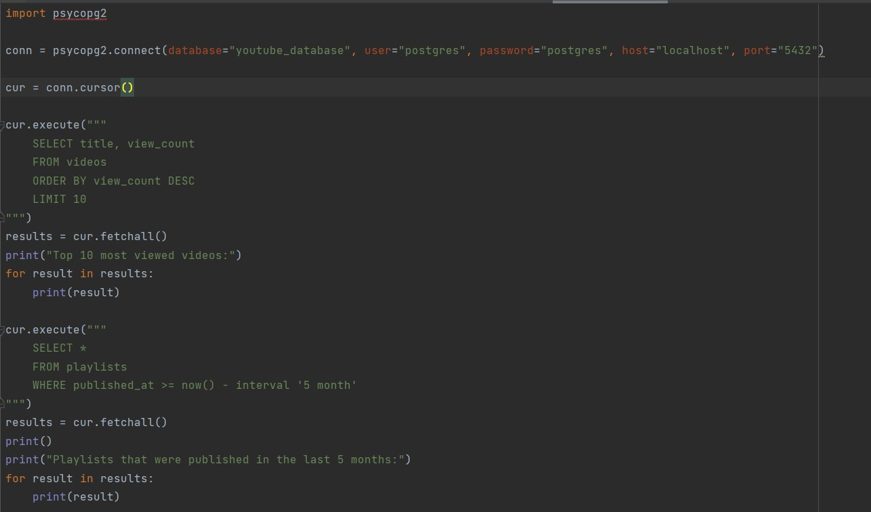
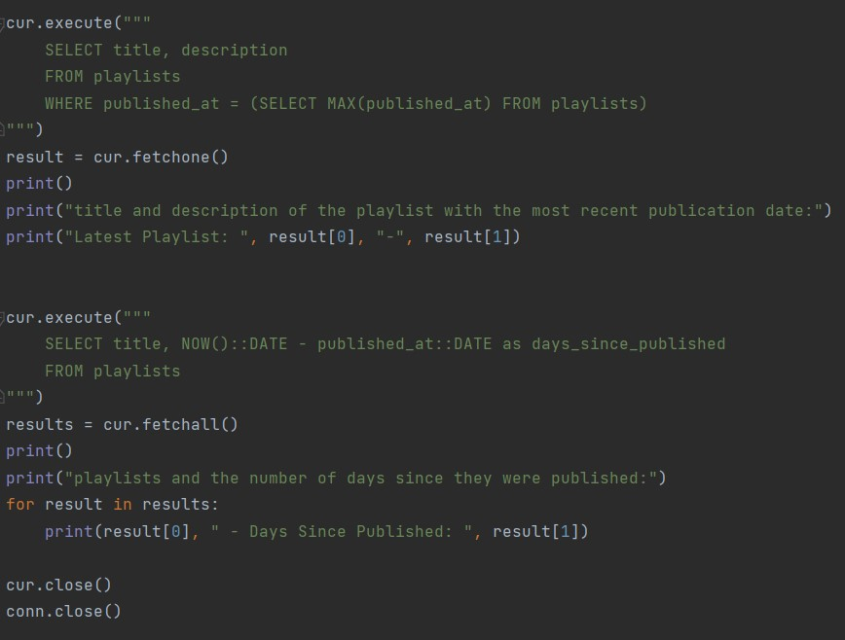
Interesting Queries

Slide 9
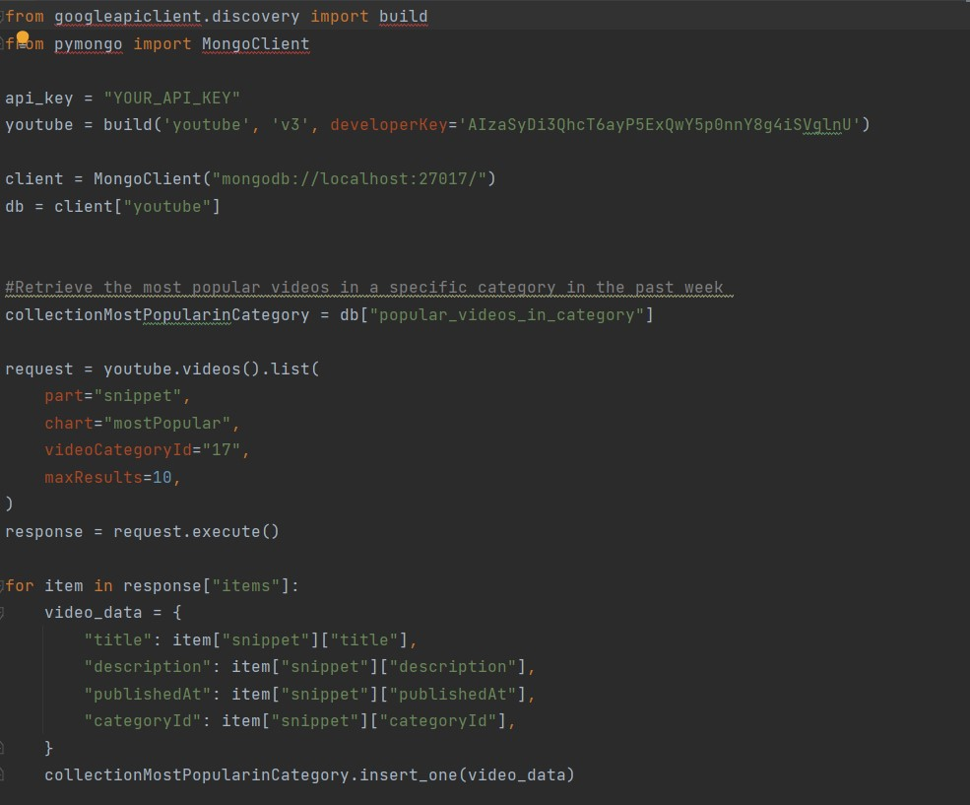
a) Create a database and collection in MongoDB. b) Automate data access by connecting the MongoDB database with API. c) Show some interesting queries.

Slide 10
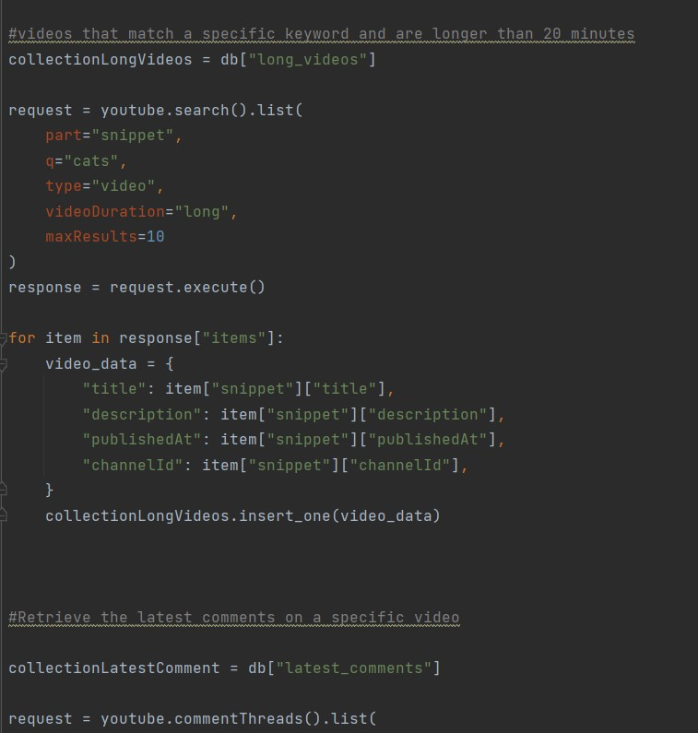

Slide 11
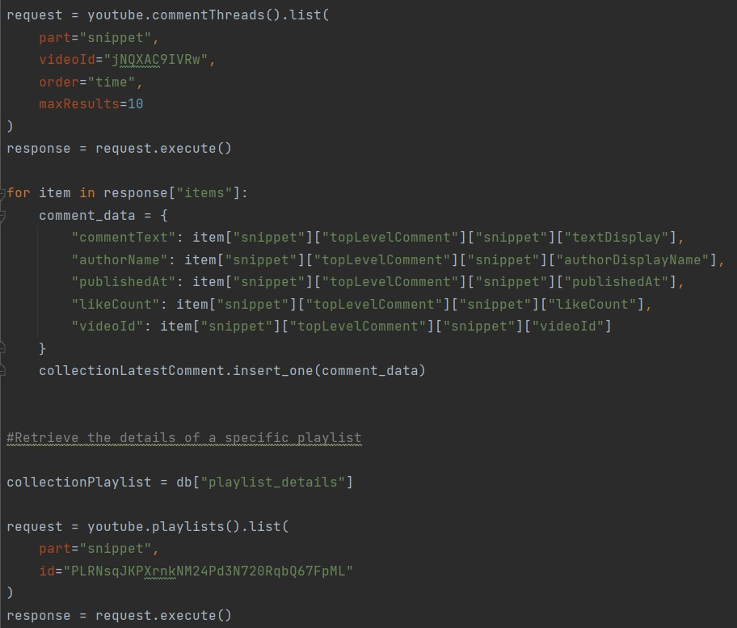
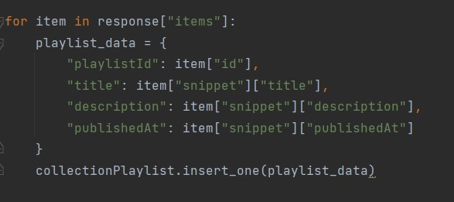

Slide 12
